Slide 1
UHV-II: Universal Human Values – Understanding harmony and Ethical Human Conduct
Module 1 – Introduction to Value Education

Slide 2
Module 1 – Introduction to Value Education (6 lectures and 3 tutorials/ practice sessions)
Lecture 1: Understanding Value Education
Lecture 2: Self-exploration as the Process for Value Education
Tutorial 1: Practice Session PS1 Sharing about Oneself
Lecture 3: Continuous Happiness and Prosperity – the Basic Human Aspirations and their Fulfilment
Lecture 4: Right Understanding, Relationship and Physical Facility
Tutorial 2: Practice Session PS2 Exploring Human Consciousness
Lecture 5: Happiness and Prosperity – Current Scenario
Lecture 6: Method to Fulfill the Basic Human Aspirations
Tutorial 3: Practice Session PS3 Exploring Natural Acceptance

Slide 3
Module 1 – Introduction to Value Education (6 lectures and 3 tutorials/ practice sessions)
Lecture 1: Right Understanding, Relationship and Physical Facility
(Holistic Development and the Role of Education)
Lecture 2: Understanding Value Education
Tutorial 1: Practice Session PS1 Sharing about Oneself
Lecture 3: Self-exploration as the Process for Value Education
Lecture 4: Continuous Happiness and Prosperity – the Basic Human Aspirations
Tutorial 2: Practice Session PS2 Exploring Human Consciousness
Lecture 5: Happiness and Prosperity – Current Scenario
Lecture 6: Method to Fulfill the Basic Human Aspirations
Tutorial 3: Practice Session PS3 Exploring Natural Acceptance

Slide 4
Lecture 1
Understanding Value Education

Slide 5


Slide 6

Expectations from Education
Education has the responsibility to facilitate:
  Understanding ‘what to do’ – What is valuable, as a human being
  and
  Learning ‘how to do’ – skills, technology
Are both required or we can do with just one of them?
Both are important
What would be the priority between these two?
The Priority is
  Understanding ‘what to do’ → Value Education
  Learning ‘how to do’ and Doing → Technical Education

Slide 7
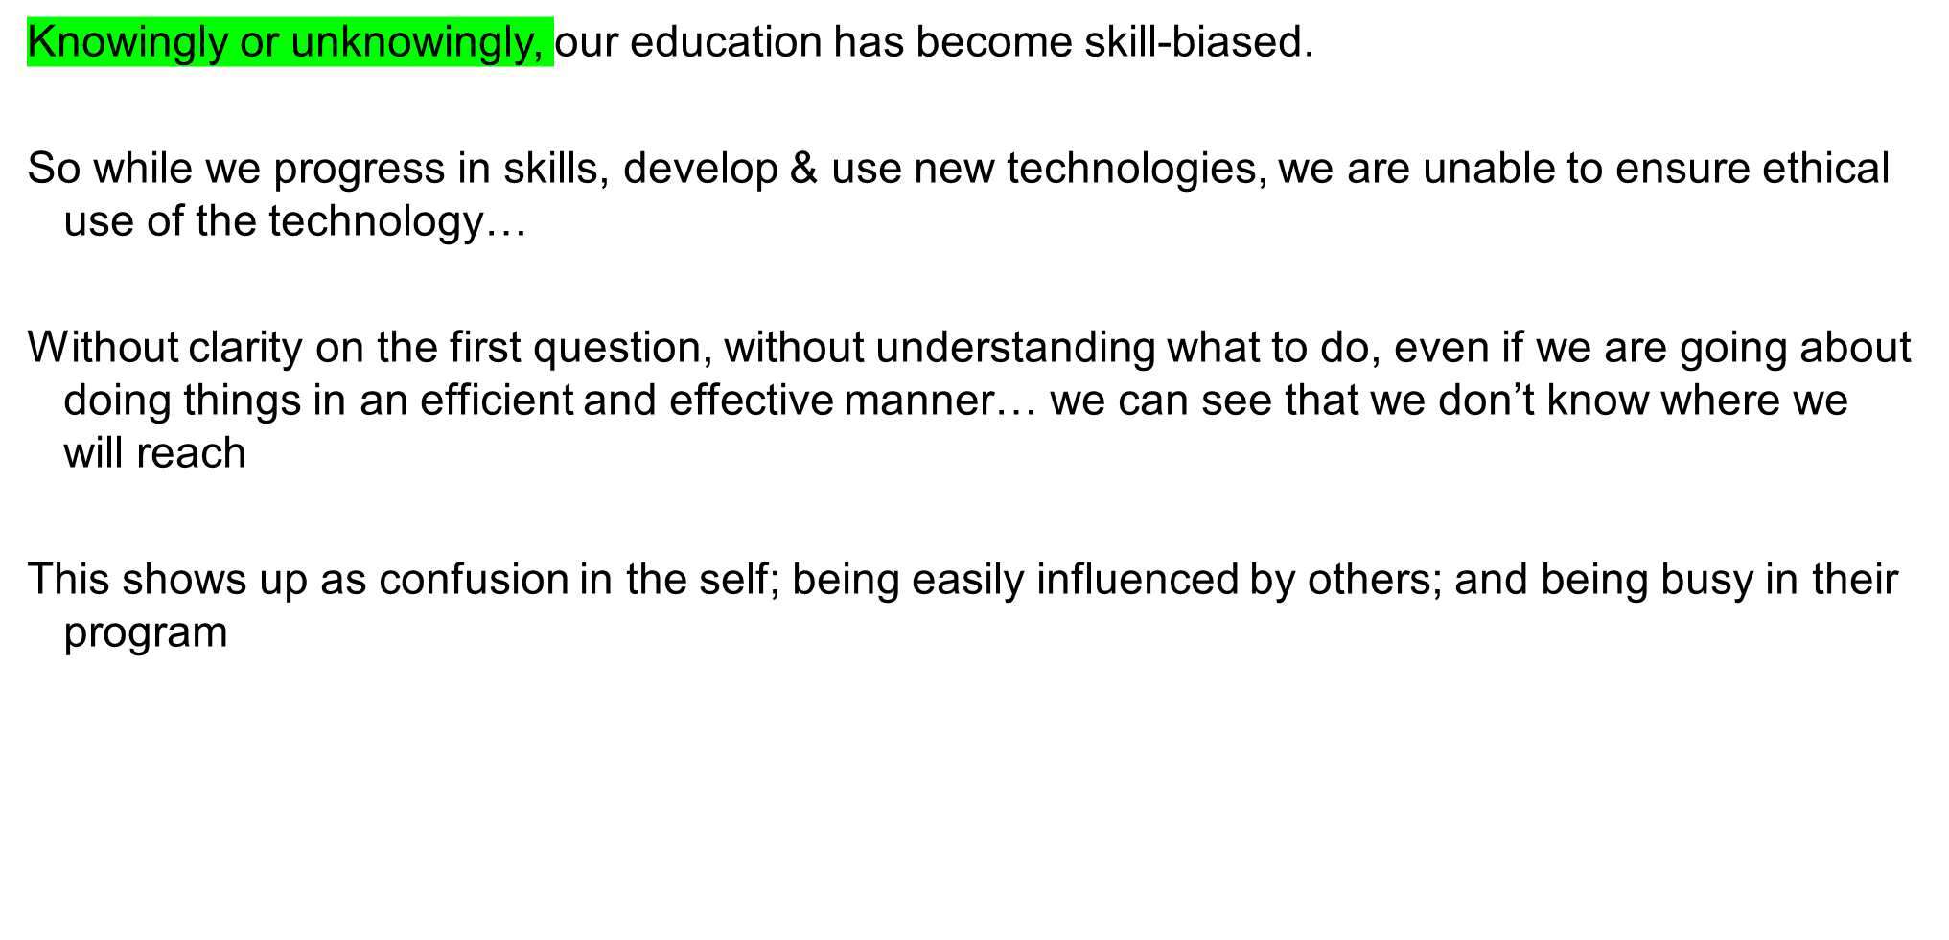
The Current Priority: Learning ‘how to do’

Slide 8
Deciding “What to Do” or “What is Valuable”
“what to do” is “what is important” is “what is valuable”
Do you want to be able to decide what to do and what not to do on your own right or
Do you want to be dependent on somebody else to decide for you?
(this somebody may be a group of people, it may be the society or the education system)
If you are not able to decide as to what is valuable what is not valuable on your own right then:
  Someone else is programming you as to what is valuable what is not valuable
  Unconsciously you keep accepting those things as values
  You are busy with how to implement them, how to realize them and materialize them

Slide 9
Deciding “What to Do” or “What is Valuable” – Example
Eg. In a professional college, the language in which students talk undergoes a drastic change in using foul language in a very short time
What is happening? Foul language is assumed to be an indication of freedom, an indication of progress… and the student starts using foul language . They are not even investigating/finding out whether it is really worth for them
Did they decide it for themselves that they want to change? Or it just happened and they are not even aware of it? Are these things happening “unconsciously”?
So, we are also being programmed generation after generation without being aware
Look into yourself – do you decide what to do or is it decided from outside?
The question is – can we become aware? Can we investigate? Can we find out what is worth for us to do?

Slide 10
Can we decide “What is Valuable” on our own right?
Is it possible to for us to decide what is valuable for us, what is meaningful, what is right, what is wrong, what is innate in us?
Can we decide these on our own right? This is the issue, this is the essential point of the first lecture
Is this possible?
We will explore into this further

Slide 11
The Need for Value Education
We saw that the first issue is that we need to understand “what to do”? And we need to learn “how to do it”?
To understand “what to do”, we need Value Education
Second, in order to ensure this we need to get into the details of things, for which we need a holistic perspective
To develop a holistic perspective, we need Value Education
So, that is the need of Value Education

Slide 12
Understanding Value
Value of a unit is its participation in the larger order
e.g. The value of a piece of chalk is its participation in the classroom
What is valuable
  The chalk writes on the blackboard in the classroom?
  or
  The chalk scratches the blackboard in the classroom?
What is valuable = value
The context is always the larger order
Value of a unit is definite (does not change with time, place, person)
The value of a unit is also referred to as its role
Thus, the role of chalk is to write on the blackboard

Slide 13
Explore
What is the value of water?
E.g. Value of water for quenching your thirst – the participation of water in quenching your thirst
Does water quench your thirst? Is it valuable?
Is its value (participation) definite?
Does it remain same over time?
Does it remain same in different places?
Is it same for different persons?
You can further reflect on the relationship between value and price

Slide 14
Human Values
Value of a human being is its participation in the larger order
  E.g. Your participation in the family defines your value in the family
  What is valuable for you? feeling of respect or feeling of disrespect?
  You feel happy when you have a feeling of respect
  The other feels happy when you express respect to him/her
Living in accordance with human values leads to mutual happiness*
  Your happiness
  Happiness of the other human being
*i.e. in the case of human-human interaction
In the case of human-rest of nature interaction,
living in accordance with human values leads to mutual prosperity

Slide 15
Understanding Human Values
In nature, every unit participates with every other unit in a mutually fulfilling manner
E.g. air nurtures plants and plants enrich air
Except for human being (who does not understand human values)
For a human being to live with human values,
s(he) has to understand human values
        E.g. for a human being to live with a feeling of respect s(he) has to understand the feeling of respect
To live with happiness, human beings have to understand human values
They have to understand their participation
They have to understand their role

Slide 16
Human Values
Value of a unit is its participation in the larger order
Human values = Value of human being is its participation in the larger order
In human-human interaction, living in accordance with human values leads to mutual happiness
  Your happiness
  Happiness of the other human being
In human-rest of nature interaction, living in accordance with human values leads to mutual prosperity
  Your prosperity
  Prosperity of rest of nature
To live with happiness and prosperity, it is essential to understand human values
Without understanding human values, one may or may not be able to live with happiness and prosperity

Slide 17
Deciding Our Values
Do you want to be able to decide on your own right?
or
Do you want somebody else to decide for you?
(this somebody may be a group of people, it may be the society or the education system, etc.)
If you are not able to decide on your own right then:
  Someone else is deciding what is valuable and what is not valuable for you
  Unconsciously you keep accepting those things as values
  You get busy with how to implement them, how to realize them, materialize them

Slide 18
Values Decided by the Other
Eg. In a professional college, many first-year students start to use foul language within a very short time
They are made to assume that this sort of language is one of the indicators of their freedom, of their own progress to adulthood… and they may adopt it as a new value
Similarly, with sleeping late and getting up late… and so many things
Did they decide it for themselves?
Did it just happen “unconsciously”, without being aware of it?
Is it worth for them? Is it fulfilling for them?
Is it fulfilling for others (like their family members)?
So, if we are unable to decide on our own right, we are programmed by the other; our values are decided by someone else…

Slide 19
Deciding Human Values on Our Own Right
Would we decide on the basis of whatever we like, whatever we believe?
  If we decide in this manner, human values will be different for different people
Or is there some definite, existential basis, something we can understand, something we can be assured about, something that ensures mutual fulfilment in living?
  If this is the case, then there is a possibility that human values are universal, they are the same for all of us
Value education is about exploring into this possibility

Slide 20
Should Education help You to Develop Holistically?
Values Value Education
Understanding What to do
Learning How to do
Doing Use of Skills
The problems around you are more due to lack of skills?
or more due to lack of values?
Are both, values and skills, required?
Both are required; Values and skills are complementary to each other
If both are required, then what is the priority?
Values (what to do) first, then skills (how to do), but both are required
What is the state in present-day education?
Education has become skill-biased
(there is a need to make appropriate changes)
Skills Skill Development
Skills guided by Values Practice

Slide 21
Basic Guidelines for Value Education
Universal
The content needs to be universal – applicable to all human beings and be true at all times, all places
It should not depend on sect, creed, nationality, race, gender, etc.
Rational
It must be amenable to logical reasoning
It should not be based on blind beliefs
Natural and Verifiable
It has to be ‘naturally acceptable’ and experientially verifiable, and not based on dogmas, beliefs or assumptions.
Should not be asked to believe just because it is stated in the course
All Encompassing
It needs to cover all dimensions (thought, behaviour, work and understanding) and levels (individual, family, society and nature/existence) of human life
Should not be confined to only few aspects of life.
Leading to Harmony
Values have to enable us to live in peace and harmony within our own self as well as with others (human being and rest of nature)
This will be sufficiently exemplified in the presentations in this workshop

Slide 22
Guidelines for Value Education
Universal
The content needs to be universal – applicable to all human beings and be true at all times, all places
It should not depend on sect, creed, nationality, race, gender, etc.
Rational
It must be amenable to logical reasoning
It should not be based on blind beliefs
Verifiable
The student should be able to verify the values on one’s own right
Should not be asked to believe just because it is stated in the course
Leading to Harmony
Values have to enable us to live in peace and harmony within our own self as well as with others (human being and rest of nature)

Slide 23
Guideline 1. Universal
It is universally applicable to all human beings and be true at all times and all places
It is about the basic principles of human existence which are universal. And if it is universal then it is not dependent on any sect, caste, creed, nationality, gender etc.
Eg. Living with a feeling of relationship is naturally acceptable to all human beings – it is universal
Q: What do you think Value Education has to be universal or sectarian? It has to be dependent on time, space and individual or independent of time, space and individual (i.e. apply equally to all of them)?
If it is universal then it is secular and it is more than that. When you say secular, it is a negation. Universal is more than secular. One of the interpretations of secularism is that we not talk about religion or sex. What has happened in the name of secularism is that we have stopped talking about human beings. So, secularism is basically a negation, not an assertion. When you say universal, it is an assertion.

Slide 24
Guideline 2. Rational
It is a set of proposals about reality, not a set of negations
It is amenable to reasoning
It is not based on whims, fancies, dogmas or blind beliefs
It is not a set of sermons
It is not a set of do’s and don’t
It is not antirational
It is not illogical
it can be communicated clearly
It can be questioned
it can be verified
It can be understood

Slide 25
Guideline 3. Verifiable
We want to verify these values ourselves, i.e. we don’t want to assume something just because something is stated, rather, each one of us will want to verify these to find out whether they are true for us
It has to be naturally acceptable, and
experientially verifiable in terms of mutual fulfilment in my behaviour and work
    Behaviour with human beings leads to mutual happiness
    Work with rest of nature leads to mutual prosperity
If it is naturally acceptable, it leads to commitment to live in that manner without being forced in any way or conditioned by another person
Every individual needs to be able to verify these values oneself

Slide 26
Guideline 4. Leading to Harmony
Finally, value education must be able to enable us to be in harmony within and live in harmony with others in the complete expanse of our being, of our living
As an individual, it needs to take care of all the dimensions of our individual existence – thought, behaviour, work and the realization
Also it must cover all levels starting from individual to family to society and to nature/existence
Hence, when we live on the basis of these values, we start understanding that it will lead to harmony in us and harmony in our interactions with other humans and the rest of nature. That is, it leads to human conduct

Slide 27
Content of Value Education
Holistic, All Encompassing
Covers all levels of human existence:
    Individual (human being)
    Family
    Society
    Nature/Existence
Eg. As a Family, Society – we want Fearlessness / Trust
NOT fear (due to mistrust / opposition)

Slide 28
Content of Value Education
Holistic, All Encompassing
Covers all levels of living:
    Individual (human being)
    Family
    Society
    Nature/Existence
Eg. As a Family, Society – we want
Fearlessness / Trust
NOT fear (mistrust / opposition)
Covers all dimensions of human being,
(as an Individual):
    Understanding/Realization
    Thought
    Behaviour
    Work/Participation in larger order
Eg. In Thought – we want clarity
(a state of resolution, solution)
NOT confusion (a state of problem)

Slide 29
Levels of Living of a Human Being
Individual
My value for myself
(eg. ensuring happiness in the self and health in the body)
Family
My value in the family
(eg. ensuring feeling of relationship and prosperity)
To live with happiness, human beings have to understand human values, i.e. their participation, their role in the larger order
Without understanding human values, they may assume something about their participation, role, which may or may not be fulfilling
Society
My value in the society
(eg. to participate in social systems for justice, peace and harmony)
Nature/Existence
My value in nature/existence
(eg. mutual fulfilment with rest of nature)

Slide 30
Dimensions of Human Being (as an Individual)
1. Understanding
2. Thought
3. Behaviour
4. Work/
Participation in the larger order

Slide 31
Process of Value Education
Universal
The content needs to be universal – applicable to all human beings and be true at all times, all places
It should not depend on sect, creed, nationality, race, gender, etc.
Rational
It must be amenable to logical reasoning… should be able to question
It should not be based on blind beliefs
Verifiable
The student should be able to verify the values on one’s own right
Should not be asked to believe just because it is stated in the course
Leading to Harmony
Values have to enable us to live in peace and harmony within our own self as well as with others (human being and rest of nature)

Slide 32
Process of Value Education – Self-exploration
Whatever is said is a Proposal
Verify it on Your Own Right – on the basis of our Natural Acceptance
Do not assume it to be true or false
It is a process of Dialogue
A dialogue between me and you, to start with
It soon becomes a dialogue within your own self
between what you are and what you really want to be (your natural acceptance)
The purpose of this course is to initiate this internal dialogue,
to help you to be self-referential, self-confident
Is this process naturally acceptable to you?
Is the purpose of this course valuable for you?
More

Slide 33

In this course, we will explore… human values, human conduct
What is my role (value) in the family?
What is my role (value) in the society?
What is my role (value) with my Body?
Who am I?
What is my purpose? What is my role (value) with myself?
What is my role (value) in Nature/existence?

Slide 34
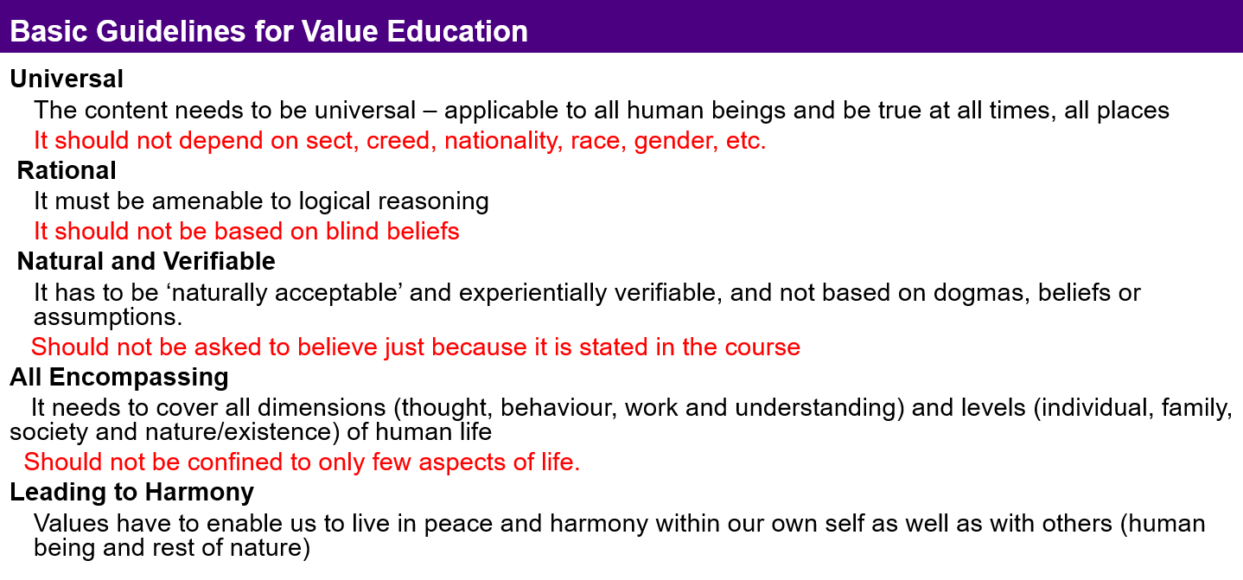
Sum Up
Need for Value Education
  To live with fulfilment, happiness, continuous happiness…
  it is essential to understand what is valuable for human being (human values)
  To understand human values, human conduct we need value education
Basic Guidelines for Value Education
Content of Value Education
All encompassing
Holistic
Process of Value Education
Self exploration, becoming Self-referential

Slide 35
Human Aspiration – As an Individual and Where are we today?
A. Living (Surviving)?
  Physical facility
B. Living with fulfilment?
  Physical facility
  Getting feelings from other
C. Living with continuous fulfilment?
  (called by different names such as bliss, peace, satisfaction, happiness, fulfilment, salvation, contentment, enlightenment, liberation, independence, self-actualisation, ecstasy, divinity,…)
  Having right understanding – in the Self (harmony in the Self,
  happiness)
  Having right feeling – in the Self (living with fulfilment in relationship with human being,
  mutual happiness)
  Physical facility – with rest of nature (living with mutual enrichment with rest of nature,
  mutual prosperity)

Slide 36
Human Aspiration – As a Society and Where are we today?
A. Families living together, in a relationship of mutual fulfillment
(common goal)
Society
B. Individuals living together, but not in relationship of mutual fulfillment
(differing goals)
Crowd
C. Individuals living separately, in opposition / struggle
(conflicting goals)
Battlefield

Slide 37
FAQs for Lecture 1
Understanding Value Education

Slide 38
Questions
Response
Preaching, Moralising, Moral Education has been tried for many years – it does not work. So, is this any different?
Values can only be caught and not taught, so what's the use of classroom teaching?
We have introduced UHV in higher education. But should not the UHV start early from childhood. Isn’t it too late to start teaching value education from college?
Due to cut-throat competition and lack of human consciousness in society, the focus of the students is on developing skill for a good pay package and not on values. How to bring their attention to values?
…

Slide 39
Value Education and its Outcome
Understanding Value Education
(definite, universal, invariant…) (proposals,
Right World-view, Perspective self-exploration,
knowing,
Self-discipline)
Natural Acceptance
Thinking Moral Education
(ideas, morals…) Belief
Doing Discipline, Instructions
(behaviour, work) (externally enforced
fear, incentive…)
Conduct is
Indefinite
Conduct is
Indefinite
Human Conduct
(Definite)

Slide 40
Can Values be Taught?
One of the misconceptions has been that
“values cannot be taught, they are caught”
Of course, values are inspired and reinforced in institutions by people who are living models of human values
From the experiments in the last 20 years in mainstream education, it is clear that:
Human values can be taught!
    Youth, regardless of their background, find it interesting when it is shared as a proposal (rather than a set of instructions or do’s and don’ts).
    They are able to explore into the proposals, discover the values intrinsic in them
    Self-exploration is an effective means of self-evolution. There is significant perceptional transformation in those exploring seriously.
√

Slide 41
Is it too Late?
We have accumulated so many problems… at every level
At the level of individual: unhappiness, dissatisfaction, a sense of purposelessness or futility, tension, frustration, depression even suicide and on the other hand show the signs of domination, violence, crime, terrorism etc. Poor health of the body…
At the level of family: deprivation, complaints, fights, inter-personal tensions, injustice and hatred…
At the level of society: poverty, unemployment, division, discrimination, exploitation, opposition, struggle and war…
At the level of nature: ecological disturbances, pollution, resource depletion, global warming, heralding larger problems and disasters soon

Slide 42
If we can start even now, Where to start from?
Where to start from: teachers or parents or policy makers?
At what level to start in education: primary or secondary or higher?
Its good to start value education right from elementary stage – children start learning values right from childhood in their homes from their parents…
So, its better to start from their parents.
But when you go to educate the parents, ultimately you have to work with grown ups.
So, we have started with higher education
Through higher education, you are directly able to address the future teachers, parents and policy makers.

Slide 43

Quiz

Slide 44
Self Reflection

Slide 45
Assignment Questions
For each slide in this presentation, mark the 1, 2 or 3 key points communicated
List 2 of the most significant problems that you see in yourself
List 3 of the most significant problems that you see in the society around you
Are these problems due to
    Lack of Skills
    Lack of Values
    Other reasons (please specify)
Do these problems have a common root cause?
If there is a common root cause, what are 3 major factors keeping you from making effort for taking care of the root cause?

Slide 46
In the effort for Self-reliance… High Focus on Skills
Stress, focus was on skills
Not able to give adequate attention to the value aspect
Right values Wrong values
Right use of skills Misuse of skills
With even more skills
Right values Wrong values
Faster, more pervasive faster and more pervasive
Right use of skills Misuse of skills
Where are we are today?

Slide 47
Question(s) 2: Need for Value Education Response
Why do we need to teach human values to students in school / college? Isn’t it the job of parents to inculcate values in their kids at home?
Due to cut-throat competition and lack of human consciousness in society, the focus of the students is on developing skill for a good pay package and not on values. How to bring their attention to values?

Slide 48
Question(s) 2: Need for Value Education Response
Why do we need to teach human values to students in school / college? Isn’t it the job of parents to inculcate values in their kids at home?
We have introduced UHV in higher education. But should not the UVH start early from childhood. Isn’t it too late to start teaching value education from college?
Due to cut-throat competition and lack of human consciousness in society, the focus of the students is on developing skill for a good pay package and not on values. How to bring their attention to values?
The parents think that they are paying for education and hence it is the job of teachers. Teachers think that our task is to cover the syllabus and conduct exams, these things are the responsibility of parents. But ultimately the need is not met. And if it is not met in the family, it is our responsibility as teachers.
Response on next slide
Every student ultimately desires for a happy and prosperous life. We need to clarify this to the student through a process of dialogue.
We are not stopping the students from going for a higher package. We are only saying that it is not the complete program for life.

Slide 49
If we can start even now, Where to start from?
Where to start from: teachers or parents or policy makers?
At what level to start in education: primary or secondary or higher?
Its good to start value education right from elementary stage – children start learning values right from childhood in their homes from their parents…
So, its better to start from their parents.
But when you go to educate the parents, ultimately you have to work with grown ups.
Teachers
Society… policy makers
So, why not start with higher education!
Through higher education, you are directly able to address the future teachers, parents and policy makers.

Slide 50
Question(s) 3: Teaching of Human Values Response
Values can only be caught and not taught. Kindly comment.
How to make value education part of life rather than just being taught as a subject in formal education?
Implementation of human values in society holds the key. It is not just sufficient to teach the students for few semesters in colleges.

Slide 51
Question(s) 3: Teaching of Human Values Response
Values can only be caught and not taught. Kindly comment.
How to make value education part of life rather than just being taught as a subject in formal education?
Implementation of human values in society holds the key. It is not just sufficient to teach the students for few semesters in colleges. They may become misfits in society like this.
Response on next slide
Through self-exploration.
The content doesn’t have to be delivered as a prescription or a moral thing, rather as an essential requirement for continuity of happiness in life.
Agreed. But one needs to be clear what is there to be implemented.
Unless there is content to explore, what will one explore? Hence the classroom input is necessary.

Slide 52
Can Values be Taught?
One of the misconceptions has been that
“values cannot be taught, they are caught”
Of course, values are inspired and reinforced in institutions by people who are living models of human values
From the experiments in the last 15 years in mainstream education, it is clear that:
Human values can be taught!
    Youth, regardless of their background, find it interesting when it is shared as a proposal (rather than a set of instructions or do’s and don’ts).
    They are able to explore into the proposals, discover the values intrinsic in them
    Self-exploration is an effective means of self-evolution. There is significant perceptional transformation in those exploring seriously.
√

Slide 53
Question(s) 4: Teaching of Human Values Response
Shouldn’t the course on UHV be taught through practical exercises or short stories or case studies of great people, in place of classroom teaching? By classroom teaching, students will only mug up the content and reproduce in the examination. This will not bring any transformation in their life.
When a child is self-exploring, it is essential to give them proposals about basic, underlying principles
Help them to explore within, find out for themselves
Answer their questions, clarify
Provide a conducive environment
We do have practice sessions
Live examples
With that it is certainly a good idea to introduce stories… particularly when the child is imitating (as in primary education)

Slide 54
Question(s) 4: Teaching of Human Values Response
Shouldn’t the course on UHV be taught through practical exercises or short stories or case studies of great people, in place of classroom teaching? By classroom teaching, students will only mug up the content and reproduce in the examination. This will not bring any transformation in their life.
There are two parts to this process:
One, to grasp the proposal which states the basic principle about life.
Secondly, to verify and validate in one’s living.
And both are necessary.
So, we need to enable our teaching methodology to include both, and not leave the second part.
Practical exercises are already included.
We can of course include short stories or case studies of great people too. But we have to ensure that the content is grasped clearly. There is always a probability that the stories or memoirs of great men give some otherwise conclusions too.

Slide 55
Question(s) 5: Teaching of Human Values Response
Students already are not interested in studies. Many of them are sent forcibly for studies. And now we are adding one more course. Is it justifiable?
Are young students mature enough to sit through lectures like this and grasp these values?
That’s why we need to include such subjects which can help them relate better to education. Students lose interest in studies when they are not able to relate the studies to their life and happiness.
Yes. Students are very much in a position to explore if the content is proposed through a process of dialogue.

Slide 56
Question(s) 6: Teaching of Human Values Response
There is a vast generation gap between the teachers and students. How to teach this course creatively given this generation gap?
Today people only look for skills and not human values. Students have a feeling that if they care about such courses, they will be lagging professionally behind. Is it really possible to teach values in such a scenario?
How to manage the contradiction between focus on marks (for admission/placement) and importance of human values for life?
The generation gap may be there in terms of living, but there is no gap in Natural Acceptance. We have to help the students reflect on their natural acceptance.
Even in industries today, they are giving higher priority to teamwork. Further, we need to make it clear to the students that their basic aspiration is continuity of happiness and prosperity and not just the physical facility.
To begin with they may feel that there is contradiction but, when they start working on human values, it is found that they become sincere towards their academics

Slide 57
Question(s) 7: Basic Guidelines and Content of Value Education Response
What do we mean by universal here? Does it include all that has been said across the world?
We are saying that we do not have to assume anything as true or false, rather verify on one’s own right. Now how do we verify on our own right whether the earth revolves around the sun or the sun around the earth?
It includes the essence of all that has been said across the world for a happy and prosperous life, a happy and prosperous society.
Universal means applicable to every human being in all time and all place.
Essentially, we do need to verify what is the relationship of any activity (reality) with me, my life and happiness.
Having verified this, then in the process of of fulfillment of this relationship, we can get the necessary information through observation or from others, (e.g. about earth, sun and their rotation).

Slide 58
Additional Question Response
What is the difference between value and meaning
There are four aspects:
1-words → 2-meaning → 3-seeing the reality
→ 4-seeing the reality in completeness
Meaning – description of certain aspect of a reality…
Value – the role of a reality at different levels
Value is relative to the context, the larger order
Value of human being as an individual
Value of human being in family
Value of human being in society, etc.
Value of human being in its completeness
Value is one of the aspects of the reality, so a meaning may indicate one of these value

Slide 59
All participants requested to respond to the poll
So far only 50% have responded

